Slide 1

PROGRAMMIMG IN JAVA
“TEXT EDITOR”
Bachelor in Technology (Computer science and engineering)
SCHOOL OF CSE (LPU) PHAGWARA
GROUP MEMBER
1. SUBHADIP DUTTA | REG NO: 12104729 | ROLLNO:RK21BGB43
2. SUBHAM RAY | REG NO:12110037 | ROLLNO:RK21BGB31
3. ANIWESH OJHA | REG NO:12111612 | ROLL NO:RK21BGA37
4. NV ANURAG | REG NO:12104883 | ROLL NO:RK21BGA25
SECTION: K21BG
Course code: CSE310
Faculty: SHRUTI MAM

Slide 2

LOVELY PROFESSIONAL UNIVERSITY
Phagwara (Punjab)

Slide 3

TABLE OF CONTENT
INTRODUCTION
PROJECT OVERVIEW
NEED OF TEXT EDITOR
CODE SNIPPET
FULL CODE WITH ALL MODULE
RESULT AND DISCUSSION
FUTURE SCOPE
CONCLUSION
ENDING AND ACKNOWLEDGEMENTS

Slide 4

INTRODUCTION
A text editor is a tool that allows a user to create and revise documents in a computer. Though this task can be carried out in other modes, the word text editor commonly refers to the tool that does this interactively.
The structure of a text editor depends largely on the types of editing features and displaying capabilities
that are to be supported. To implement the diplaying capabilities, the semantics of the meta data that may be present in the document file needs
to be implemented as display actions.
A text editor is program that allows you to open, view, and edit plain text files. Unlike word processors, text editors do not add formatting to text, instead focusing on editing functions for plain text. Text editors are used by a wide variety of people, for a wide variety of purposes.

Slide 5
PROJECT OVERVIEW
To create a simple text editor in Java Swing we will use a JTextArea, a JMenuBar and add JMenu to it and we will add JMenuItems. All the menu items will have actionListener to detect any action.
There will be a menu bar and it will contain two menus and a button:
File menu
open: this menuitem is used to open a file
save: this menuitem is used to save a file
print : this menuitem is used to print the components of the text area
new : this menuitem is used to create a new blank file
Edit menu
cut: this menuitem is to cut the selected area and copy it to clipboard
copy: this menuitem is to copy the selected area to the clipboard
paste : this menuitem is to paste the text from the clipboard to the text area
Close : this button closes the frame

Slide 6
method | explanation
cut() | removes the selected area from the text area and store it in clipboard
copy() | copies the selected area from the text area and store it in clipboard
paste() | removes the selected area from the text area and store it in clipboard
print() | prints the components of the text area
NEED OF TEXT EDITOR
A text editor is a computer program that enables
users to create, change, or edit plain text files (i.e.,
files with the suffix .txt). They’re often used to craft
complex code for websites; read, create and edit
source code; or build text files.
It improves user experience by going beyond regular text editing.
It has a place on most websites and web apps
It allows non-technical users to build pages or make content with little or no coding

Slide 7
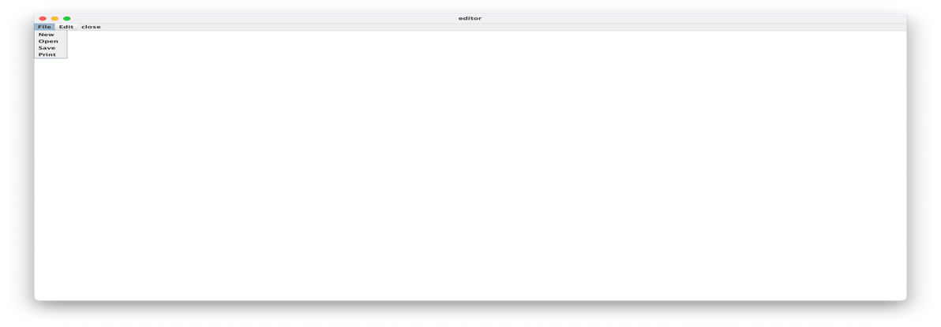
CODE SNIPPET
Create a frame
f = new JFrame("editor");
try {
// Set metal look and feel UIManager.setLookAndFeel("javax.swing.plaf.meta
l.MetalLookAn");
// Set theme to ocean MetalLookAndFeel.setCurrentTheme(new
OceanTheme());
}
catch (Exception e) {
}
Create a menubar
JMenuBar mb = new JMenuBar();
Create amenu for menu
JMenu m1 = new JMenu("File");
Create menu items
JMenuItem mi1 = JMenuItem mi2 = JMenuItem mi3 = JMenuItem mi9 =
new JMenuItem("New"); new JMenuItem("Open"); new JMenuItem("Save"); new JMenuItem("Print");

Slide 8
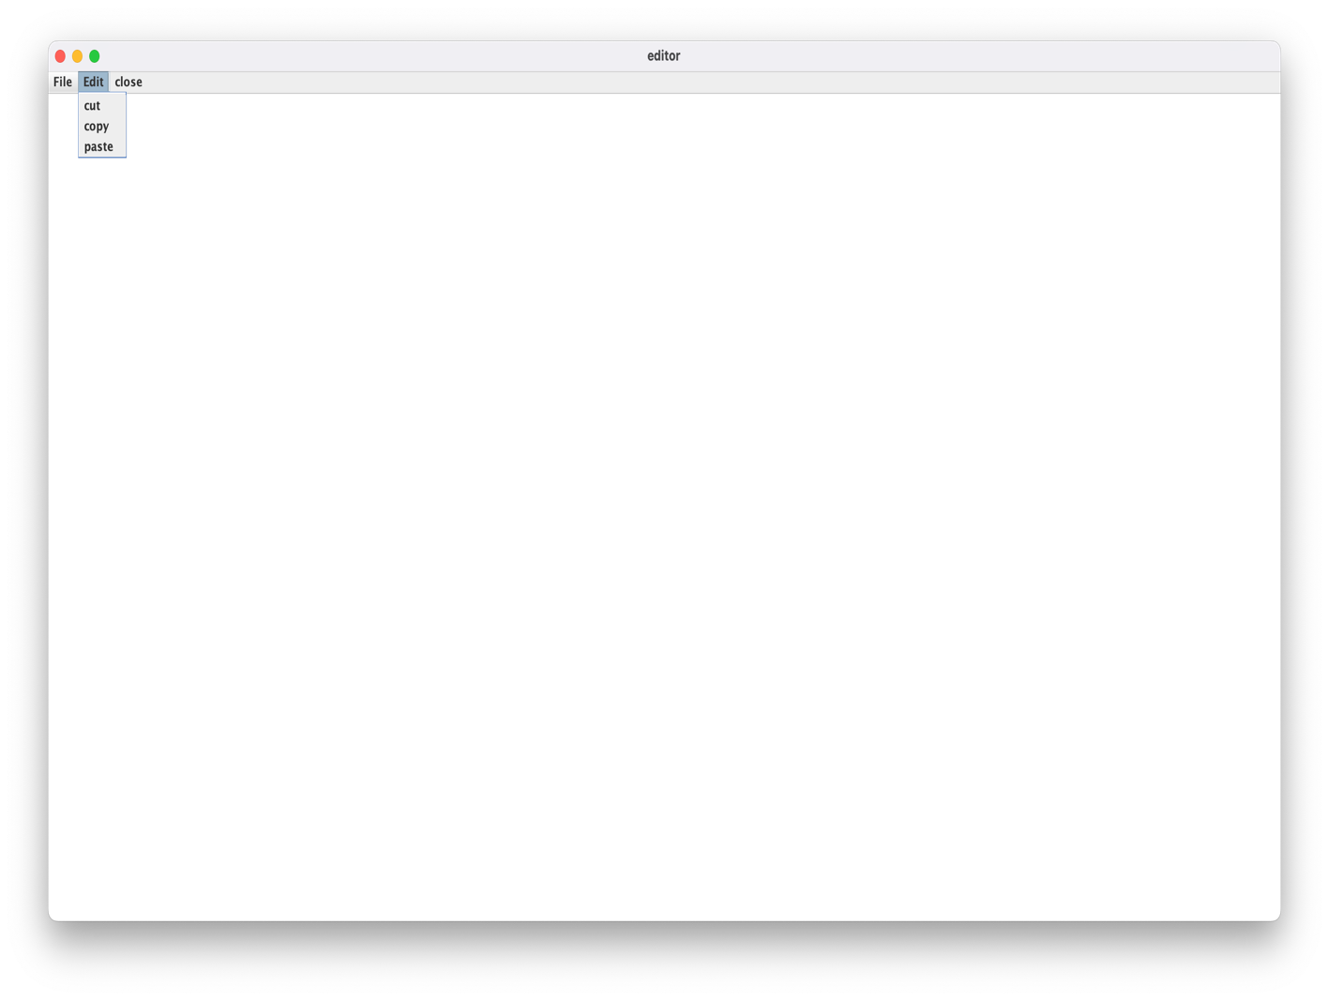
Add action listener
mi1.addActionListener(this); mi2.addActionListener(this); mi3.addActionListener(this); mi9.addActionListener(this);
m1.add(mi1);
m1.add(mi2);
m1.add(mi3);
m1.add(mi9);
Create menu items
JMenuItem mi4 = JMenuItem mi5 = JMenuItem mi6 =
new JMenuItem("cut"); new JMenuItem("copy"); new JMenuItem("paste");

Slide 9
Add action listener
mi4.addActionListener(this); mi5.addActionListener(this); mi6.addActionListener(this);
m2.add(mi4);
m2.add(mi5);
m2.add(mi6);
JMenuItem mc = new JMenuItem("close"); mc.addActionListener(this); mb.add(m1);
mb.add(m2);
mb.add(mc);
f.setJMenuBar(mb); f.add(t); f.setSize(500, 500); f.show();
}
If a button is pressed
public void actionPerformed(ActionEvent e)
{
String s = e.getActionCommand();
if (s.equals("cut")) { t.cut();
}
else if (s.equals("copy")) { t.copy();
}
else if (s.equals("paste")) { t.paste();
}
else if (s.equals("Save")) {

Slide 10
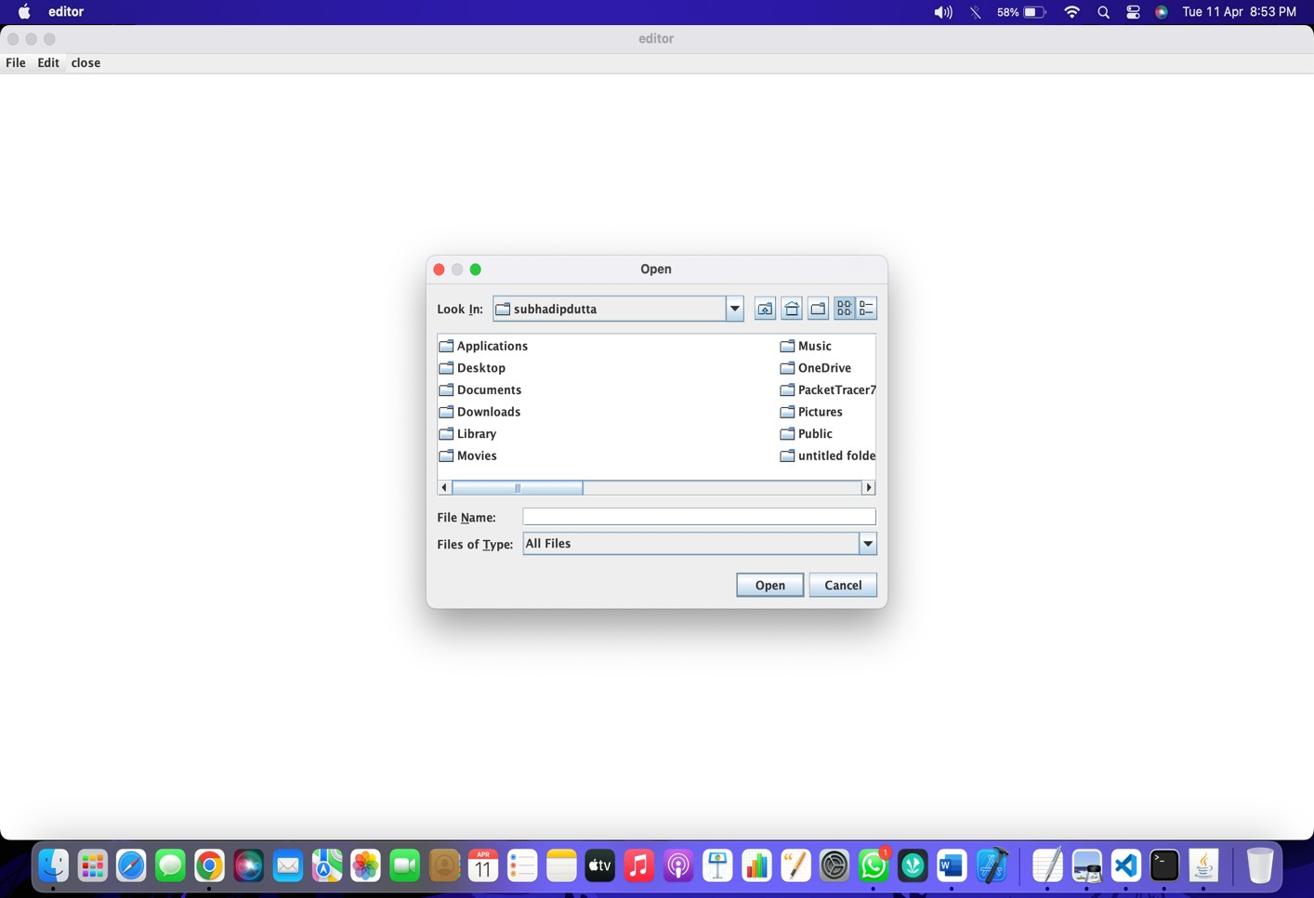
FULL CODE WITH ALL MODULE:-
// Java Program to create a text editor using java import java.awt.*;
import javax.swing.*; import java.io.*;
import java.awt.event.*;
import javax.swing.plaf.metal.*; import javax.swing.text.*;
class editor extends JFrame implements ActionListener {
// Text component JTextArea t;
// Frame JFrame f;
// Constructor editor()

Slide 11
{
// Create a frame
f = new JFrame("editor");
try {
// Set metal look and feel
UIManager.setLookAndFeel("javax.swing.plaf.metal.MetalLookAndFeel")
;
// Set theme to ocean MetalLookAndFeel.setCurrentTheme(new OceanTheme());
}
catch (Exception e) {
}
// Text component
t = new JTextArea();
// Create a menubar
JMenuBar mb = new JMenuBar();
// Create amenu for menu
JMenu m1 = new JMenu("File");
// Create menu items
JMenuItem mi1 = new JMenuItem("New"); JMenuItem mi2 = new JMenuItem("Open");
JMenuItem mi3 = new JMenuItem("Save"); JMenuItem mi9 = new JMenuItem("Print");
// Add action listener mi1.addActionListener(this); mi2.addActionListener(this); mi3.addActionListener(this); mi9.addActionListener(this);
m1.add(mi1);
m1.add(mi2);
m1.add(mi3);

Slide 12
m1.add(mi9);
// Create amenu for menu
JMenu m2 = new JMenu("Edit");
// Create menu items
JMenuItem mi4 = new JMenuItem("cut");
JMenuItem mi5 = new JMenuItem("copy"); JMenuItem mi6 = new JMenuItem("paste");
// Add action listener mi4.addActionListener(this); mi5.addActionListener(this); mi6.addActionListener(this);
m2.add(mi4);
m2.add(mi5);
m2.add(mi6);
JMenuItem mc = new JMenuItem("close"); mc.addActionListener(this);
mb.add(m1);
mb.add(m2);
mb.add(mc);
f.setJMenuBar(mb); f.add(t); f.setSize(500, 500); f.show();
}
// If a button is pressed
public void actionPerformed(ActionEvent e)
{
String s = e.getActionCommand();
if (s.equals("cut")) { t.cut();

Slide 13
}
else if (s.equals("copy")) { t.copy();
}
else if (s.equals("paste")) { t.paste();
}
else if (s.equals("Save")) {
// Create an object of JFileChooser class JFileChooser j = new JFileChooser("f:");
// Invoke the showsSaveDialog function to show the save
dialog
int r = j.showSaveDialog(null);
if (r == JFileChooser.APPROVE_OPTION) {
// Set the label to the path of the selected directory File fi = new
File(j.getSelectedFile().getAbsolutePath());
try {
// Create a file writer
FileWriter wr = new FileWriter(fi, false);
// Create buffered writer to write BufferedWriter w = new BufferedWriter(wr);
// Write w.write(t.getText());
w.flush();
w.close();
}
catch (Exception evt) { JOptionPane.showMessageDialog(f,
evt.getMessage());
}
}
// If the user cancelled the operation

Slide 14
else
JOptionPane.showMessageDialog(f, "the user cancelled
the operation");
}
else if (s.equals("Print")) { try {
// print the file t.print();
}
catch (Exception evt) {
JOptionPane.showMessageDialog(f, evt.getMessage());
}
}
else if (s.equals("Open")) {
// Create an object of JFileChooser class JFileChooser j = new JFileChooser("f:");
// Invoke the showsOpenDialog function to show the save
dialog
int r = j.showOpenDialog(null);
// If the user selects a file
if (r == JFileChooser.APPROVE_OPTION) {
// Set the label to the path of the selected directory File fi = new
File(j.getSelectedFile().getAbsolutePath());
try {
// String
String s1 = "", sl = "";
// File reader
FileReader fr = new FileReader(fi);
// Buffered reader
BufferedReader br = new BufferedReader(fr);
// Initialize sl
sl = br.readLine();

Slide 15
// Take the input from the file
while ((s1 = br.readLine()) != null) { sl = sl + "\n" + s1;
}
// Set the text t.setText(sl);
}
catch (Exception evt) { JOptionPane.showMessageDialog(f,
evt.getMessage());
}
}
// If the user cancelled the operation else
JOptionPane.showMessageDialog(f, "the user cancelled
the operation");
}
else if (s.equals("New")) {
t.setText("");
}
else if (s.equals("close")) { f.setVisible(false);
}
}
// Main class
public static void main(String args[])
{
editor e = new editor();
}
}

Slide 16
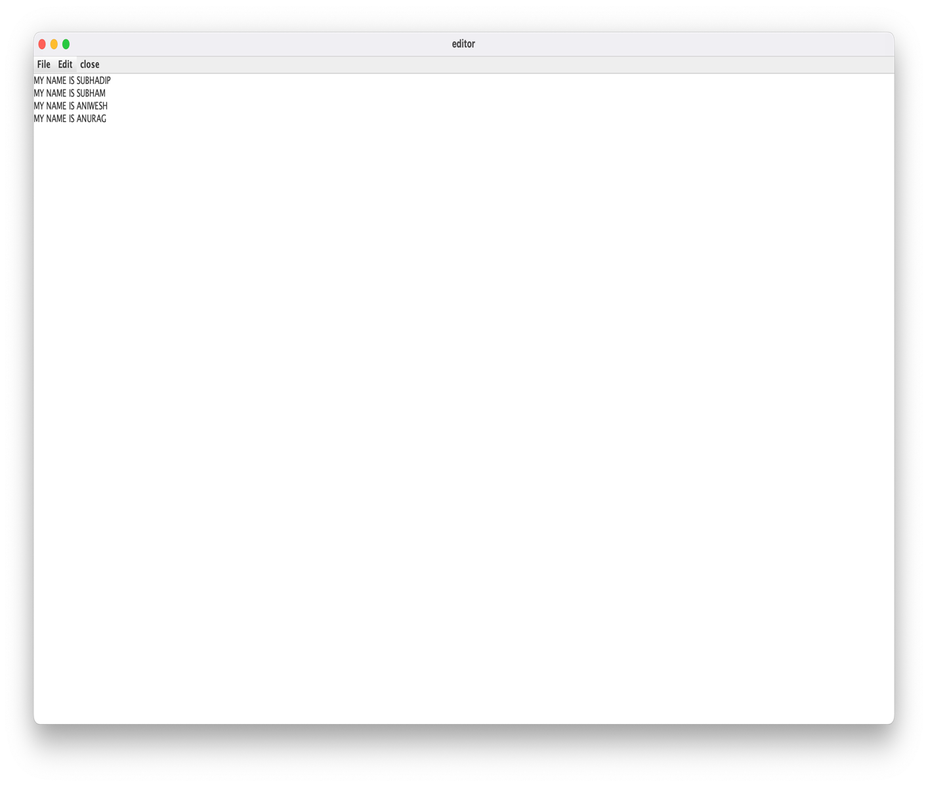
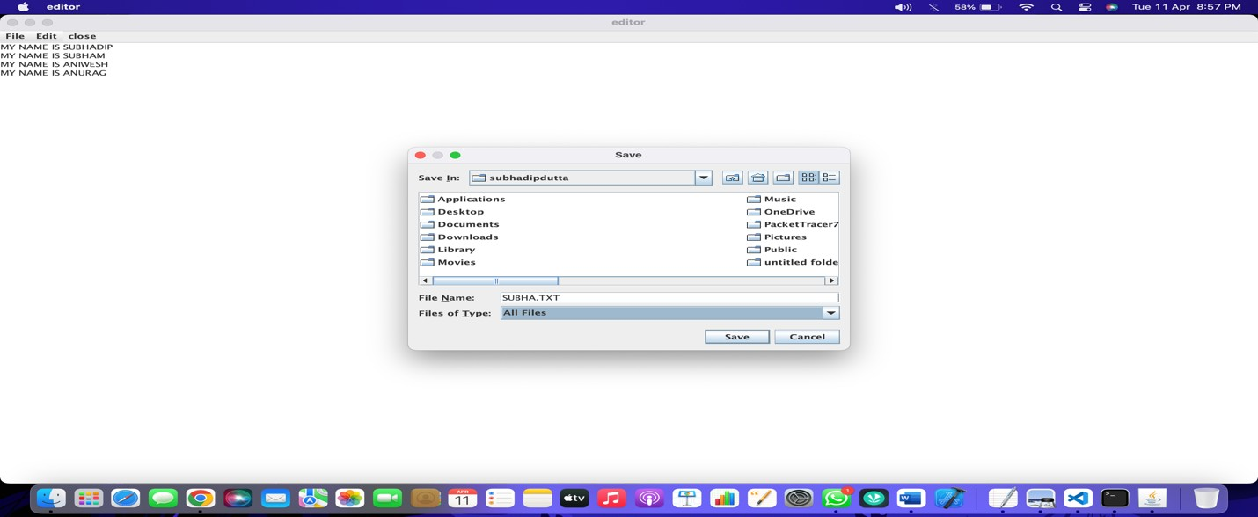

Slide 17
RESULT AND DISCUSSION
The Text Editor Java Project was a success. We were able to successfully implement a Text Editor using Java, which allows a user to create and revise documents in a computer.
Though this task can be carried out in other modes, the word text editor commonly refers to the tool that does this
interactively.
 | Copy, paste, and cut, along with finding and replacing
words and creating bulleted lists, are typical across text
editor platforms.
Whereas the output of pure text editors is plain text only, word processors can also produce output in at least one binary format, and often in a number of binary formats. A binary format is one in which at least part of the data is in non-plain text form.

Slide 18
FUTURE SCOPE
The text editor Java project has a vast potential for future improvements and enhancements. Here are some potential future scopes for the project:
1. A text editor is program that allows you to open, view, and edit plain text files. Unlike word processors, text editors do not add formatting to text, instead focusing on editing functions for plain text. Text editors are used by a wide variety of people, for a wide variety of purposes.
Content editors are responsible for researching, proofreading, and publishing both traditional and online media. They analyze readership data and develop content strategies to increase user engagement. Content editors also fact-check articles and ensure the use of proper spelling, grammar, and syntax in outputs.
Text formatting – Text editors often provide basic visual formatting features like line wrap, auto- indentation, bullet list formatting using ASCII characters, comment formatting, syntax highlighting and so on.

Slide 19
CONCLUSION
In conclusion, text editor Java project can be a challenging but rewarding endeavor. By following the proposed methodology, the project can achieve high levels of accuracy in identifying faces, making it useful for various applications, such as security, access control, and human-computer interaction.
The project's future scope is significant, with opportunities to improve accuracy, speed, and security using advanced technologies such as deep learning, multi-modal recognition, and cloud-based face recognition. These enhancements can provide more effective and efficient solutions for real-world problems.
However, the project also has its challenges and limitations, such as dealing with low-quality features.
Overall, a text editor project can provide a foundation for building more advanced and sophisticated systems in the future.

Slide 20
ENDING AND ACKNOWLEDGEMENTS
In conclusion, we would like to express our sincere gratitude to you, Shruti Ma'am, for guiding us throughout the development of this text editor Java project. Your unwavering support and encouragement helped us navigate the challenges and complexities of the project, and your valuable feedback and suggestions greatly contributed to its success.
We would also like to extend our appreciation to the opensource community and the developers whose work made it possible for us to utilize a wide range of libraries and frameworks to develop the project. We would like to thank our colleagues and friends who provided their support and feedback during the development process.
Once again, we thank you for your invaluable support and guidance throughout this project. It was a privilege to work under your supervision.

Slide 21

THANK YOU

